Slide 1

Computer Networks
Presented By:
Elizer Ponio Jr.

Slide 2
What is a Computer Network?
A computer network is a collection of computers, servers, mainframes, network devices, peripherals, or other devices connected to allow data sharing.
An example of a network is the Internet, which connects millions of people all over the world.
Computer networks are very common and appear in places such as homes, offices and government administrations.

Slide 3
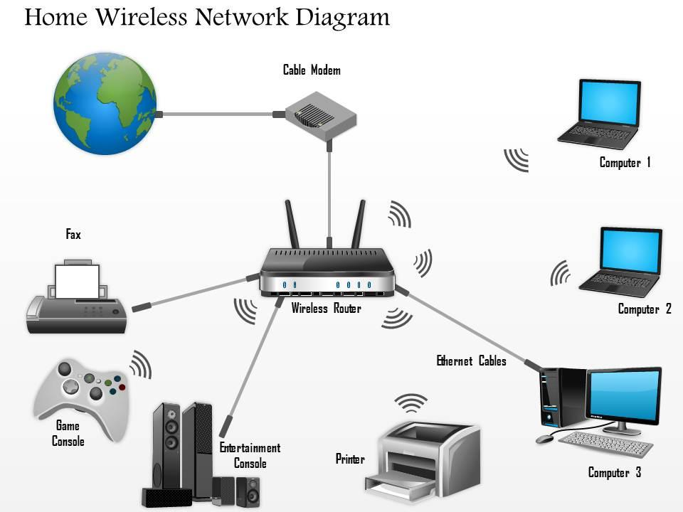
An example of a typical home network

Slide 4
Uses
Computer networks have a variety of uses that many would see as essential today.
File Sharing
Application Sharing
Hardware Sharing
Communication
Gaming
E-commerce

Slide 5
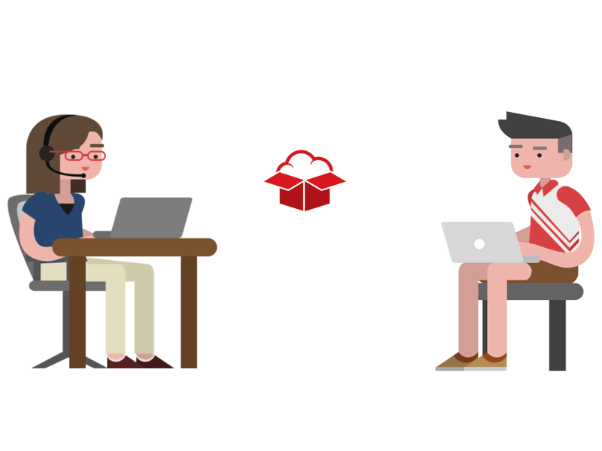
File Sharing
Notes:
file sharing, which enables users to share data files through a network;

Slide 6
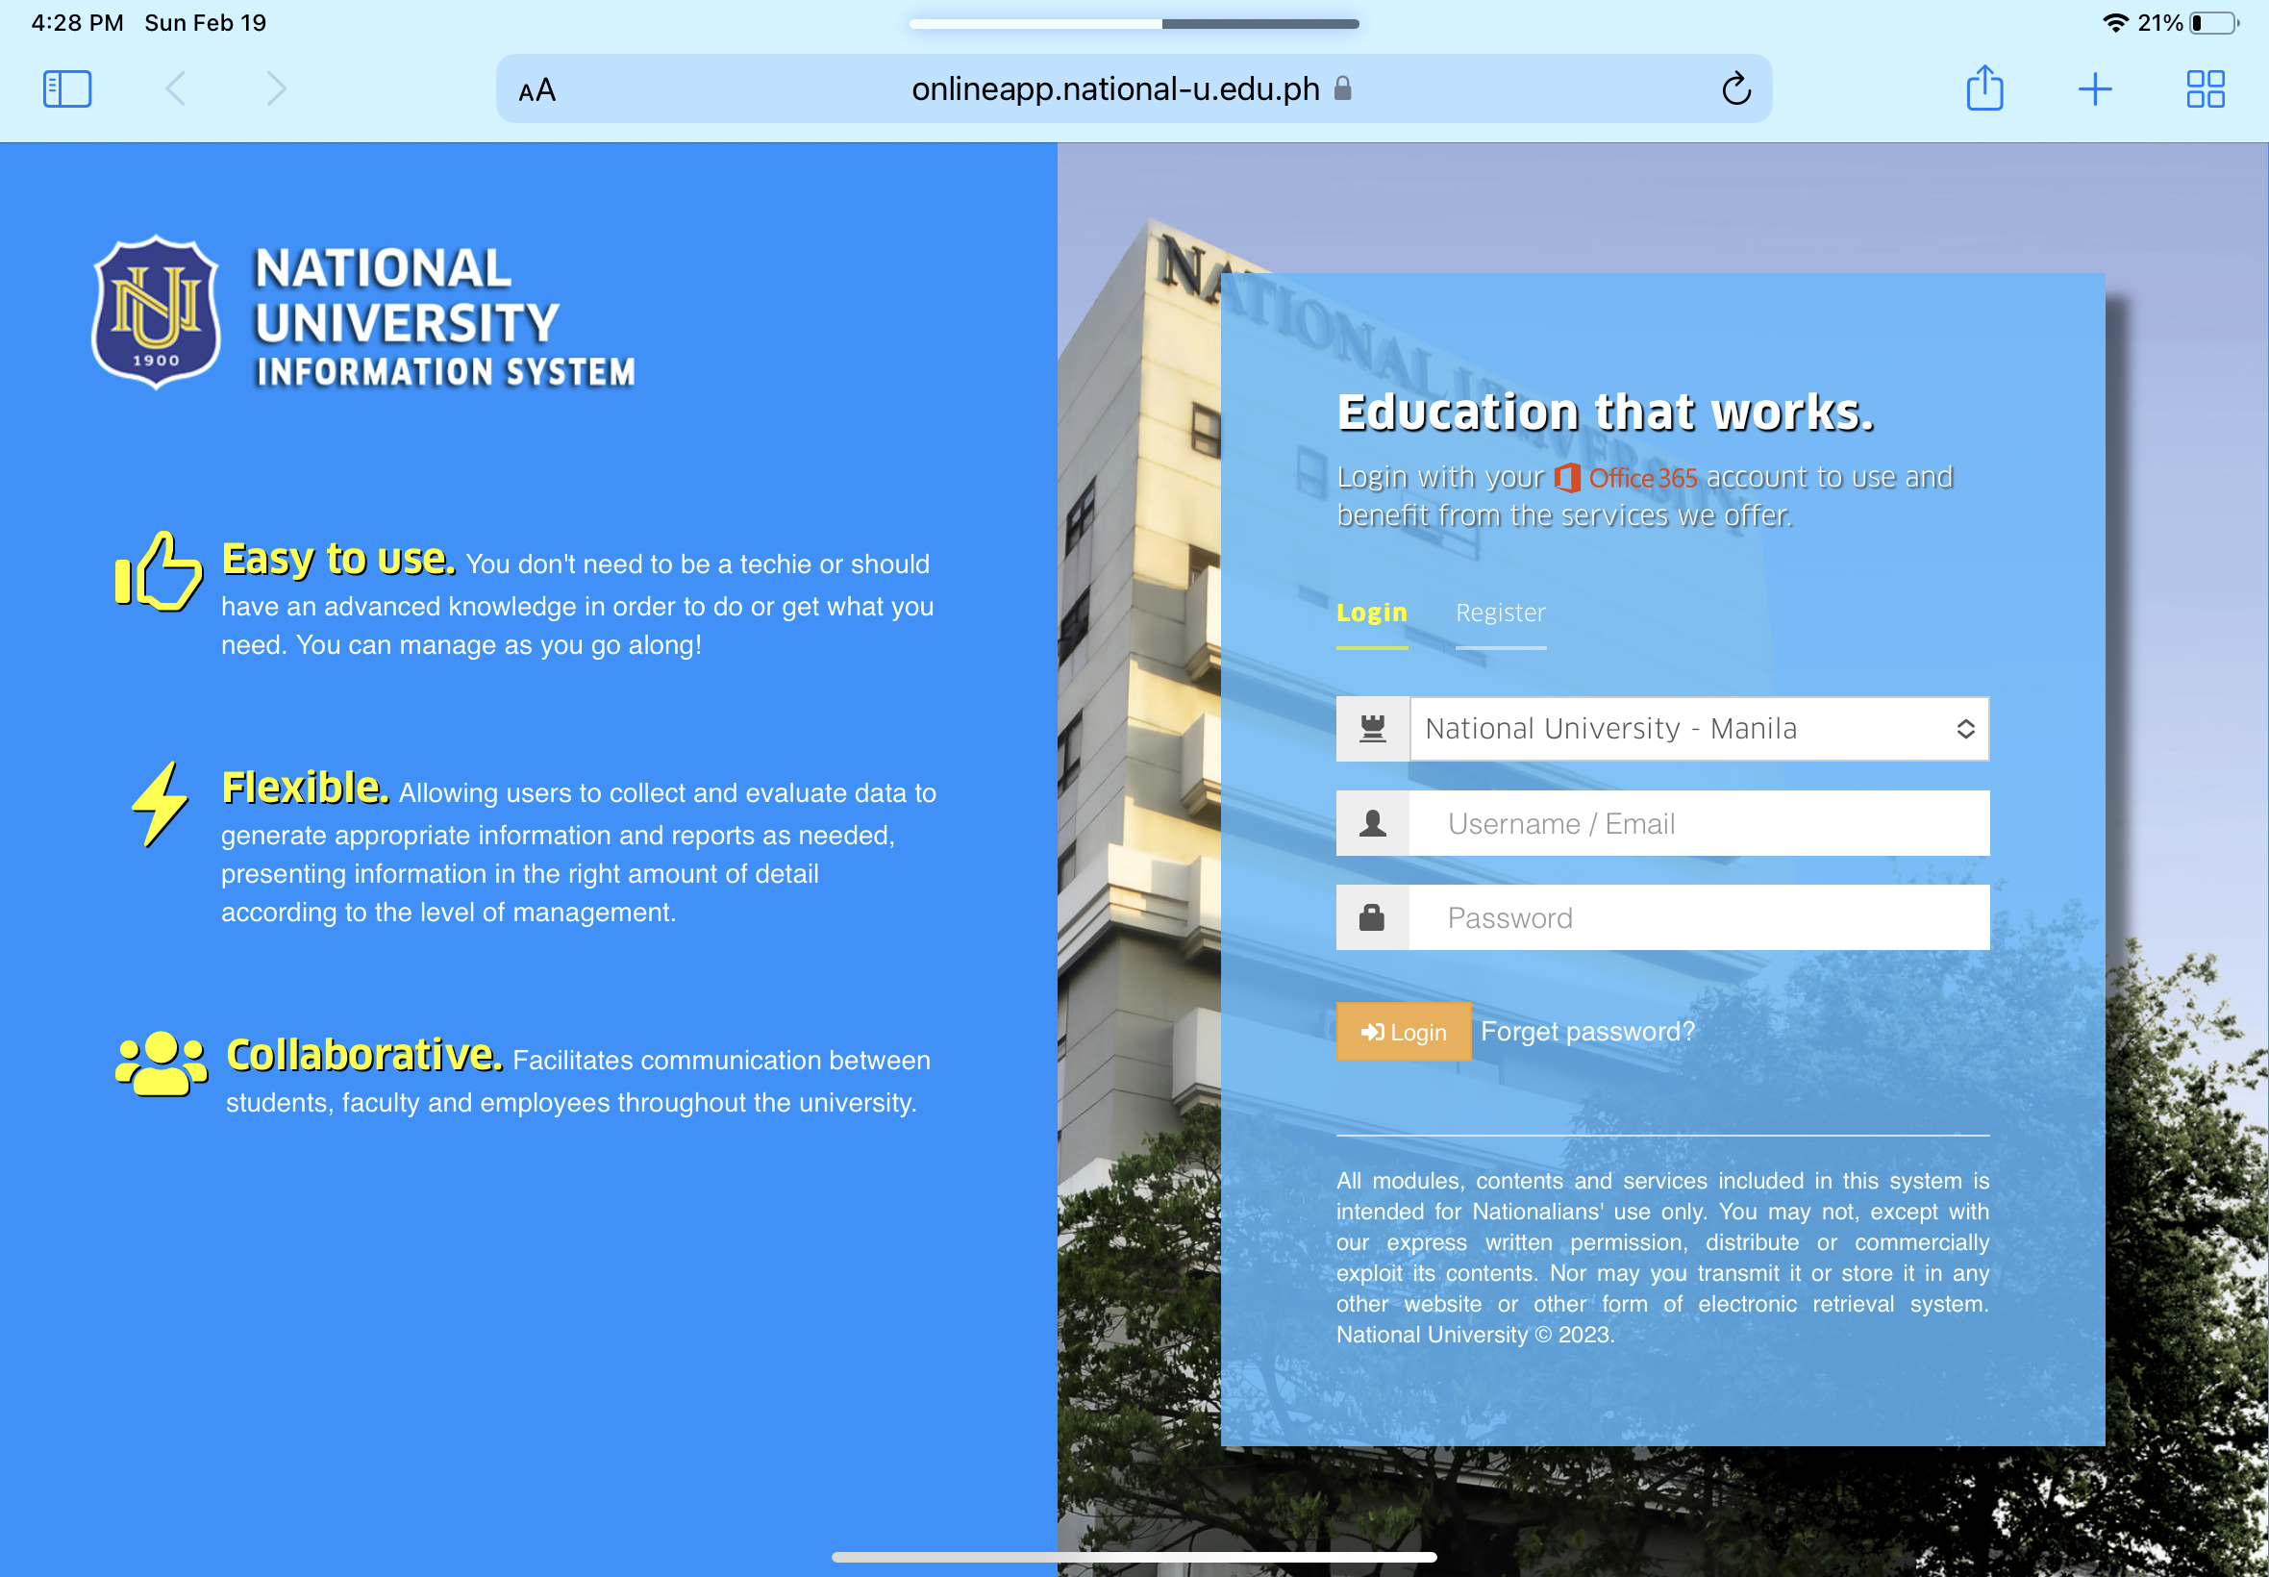
Application Sharing
Notes:
application sharing, which enables users to share applications through a network;

Slide 7
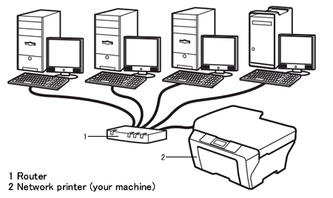
Hardware Sharing
Notes:
hardware sharing, which enables users in a network to share hardware devices, such as printers and hard drives;

Slide 8



Cloud Services
Notes:
client-server model, which enables data to be stored on servers, where end-user devices -- or clients -- can access that data;

Slide 9

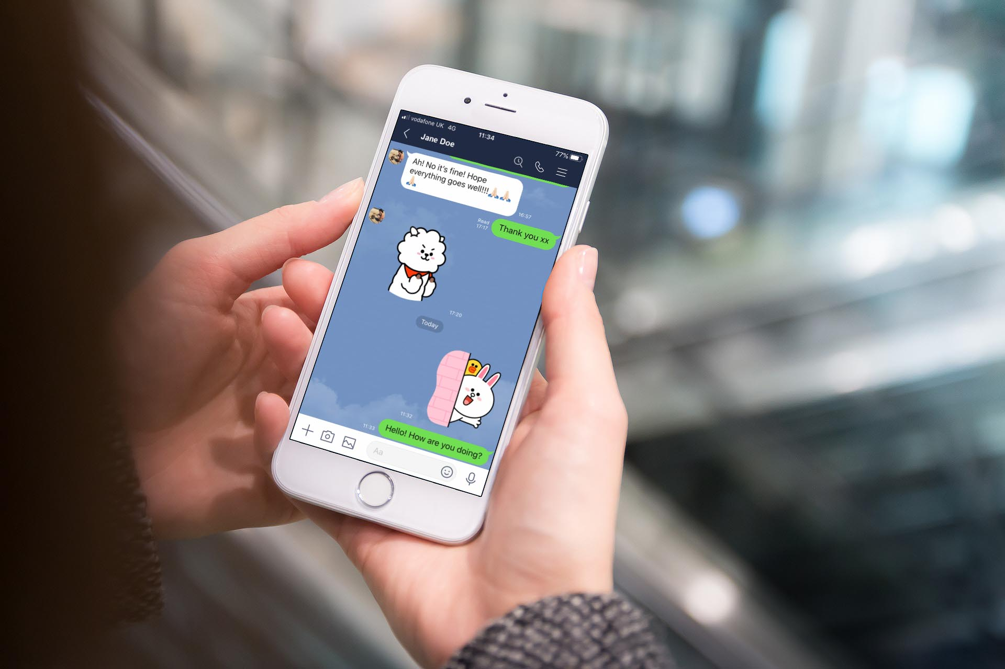
Communication
Notes:
communication, which can include video, text and voice;

Slide 10


Gaming
Notes:
gaming, which enables multiple users to play together from various locations.

Slide 11
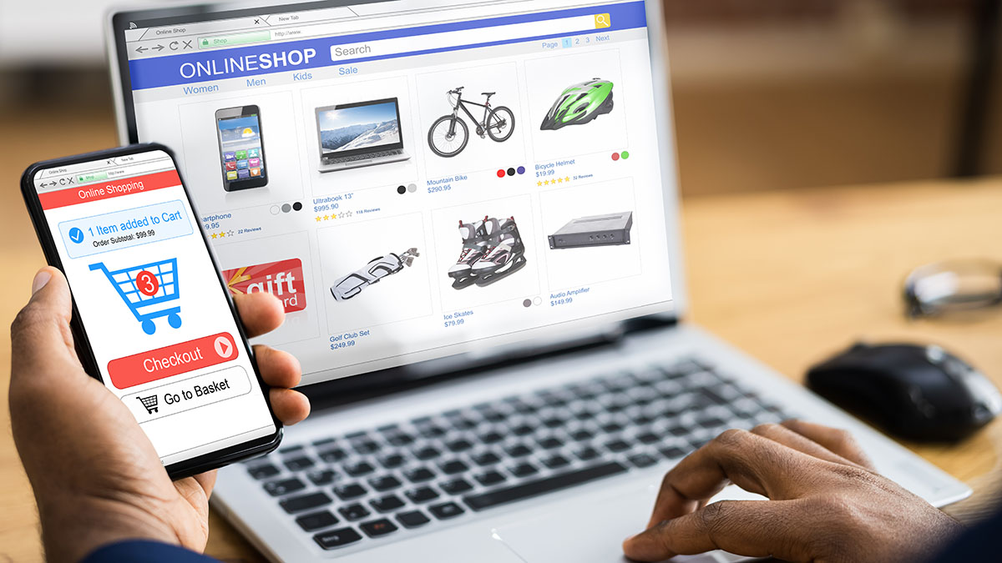
E-commerce
Notes:
E-commerce, which enables users to sell and buy products over the internet; and

Slide 12
Types of Computer Networks
Networks are often categorized by the wired or wireless transmission technology they support, as well as the scope of their domains.
Some examples of computer networks include the following:
Personal area network (PAN), a network used by just one person to connect multiple devices, such as laptops to scanners, etc.
Local area networks (LANs), which connects devices within a limited geographical area, such as schools, hospitals, or office buildings.
Wide area networks (WANs), which interconnect multiple LANs.

Slide 13
Types of Computer Networks
Metropolitan area networks (MANs), which interconnect computer resources in a geographic area such as a city.
Virtual private networks (VPNs), which provides a secure connection between a computing device and a computer network, or between two networks, using an insecure communication medium such as the public Internet.

Slide 14
Network Topology
A network topology is the physical or logical structure of a network.
Full mesh network. All nodes are connected to each other and can exchange data.
Star network. All network nodes are connected to a common central computer.
Tree network. Two or more star networks are connected together.

Slide 15
Network Topology
Bus network. Network devices are attached directly to a transmission line. All signals pass through all devices, but each device has a unique identity and recognizes signals intended for it.
Ring network. Network devices are connected to each other in a ring format, where each device is connected to at least two other devices.

Slide 16
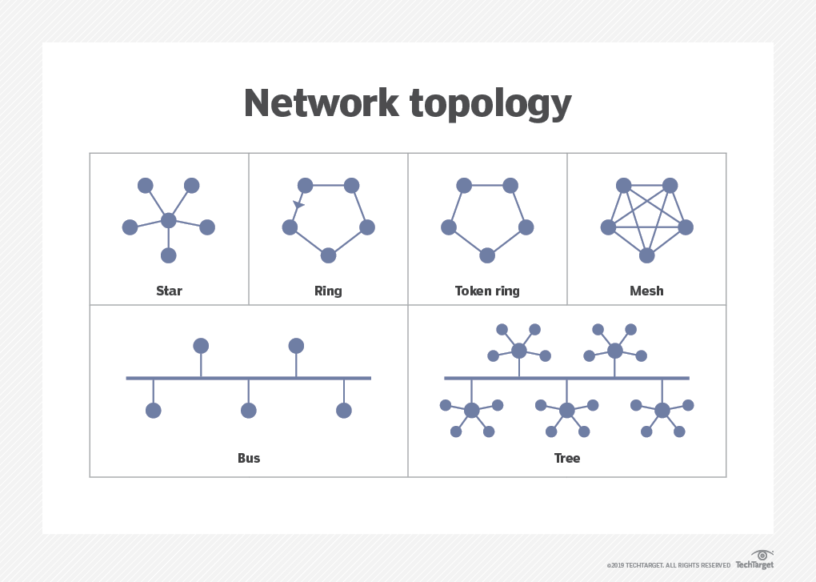

Slide 17
Network Classifications
Intranet. Intranet is a set of networks that is maintained and controlled by a single entity. It is generally the most secure type of network, with access to authorized users alone. An intranet usually exists behind the router in a local area network.
Internet. The internet (or the internetwork) is a collection of multiple networks connected by routers and layered by networking software. This is a global system that connects governments, researchers, corporates, the public, and individual computer networks.

Slide 18
Network Classifications
Extranet. An extranet is similar to the intranet but with connections to particular external networks. It is generally used to share resources with partners, customers, or remote employees.
Darknet. The darknet is an overlay network that runs on the internet and can only be accessed by specialized software. It uses unique, customized communication protocols.

Slide 19
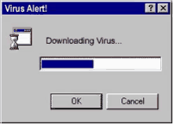
Disadvantages of a Computer Network
Virus and malware - Networks make sharing information between network users easy. Unfortunately, this also means that viruses and malware have an easier time spreading between computers on a network.

Slide 20

Disadvantages of a Computer Network
Network exploitation. If a network is not properly secured, other people can breach the network and steal important data.

Slide 21

Disadvantages of a Computer Network
Cost and complexity. Networks are costly and setting up and managing a network for a business or corporation requires someone with a lot of experience or certification.

